Slide 1
AGILE SOFTWARE ENGINEERING AND DEVOPS
Assignment 5
By U.MERSHIKA

Slide 2
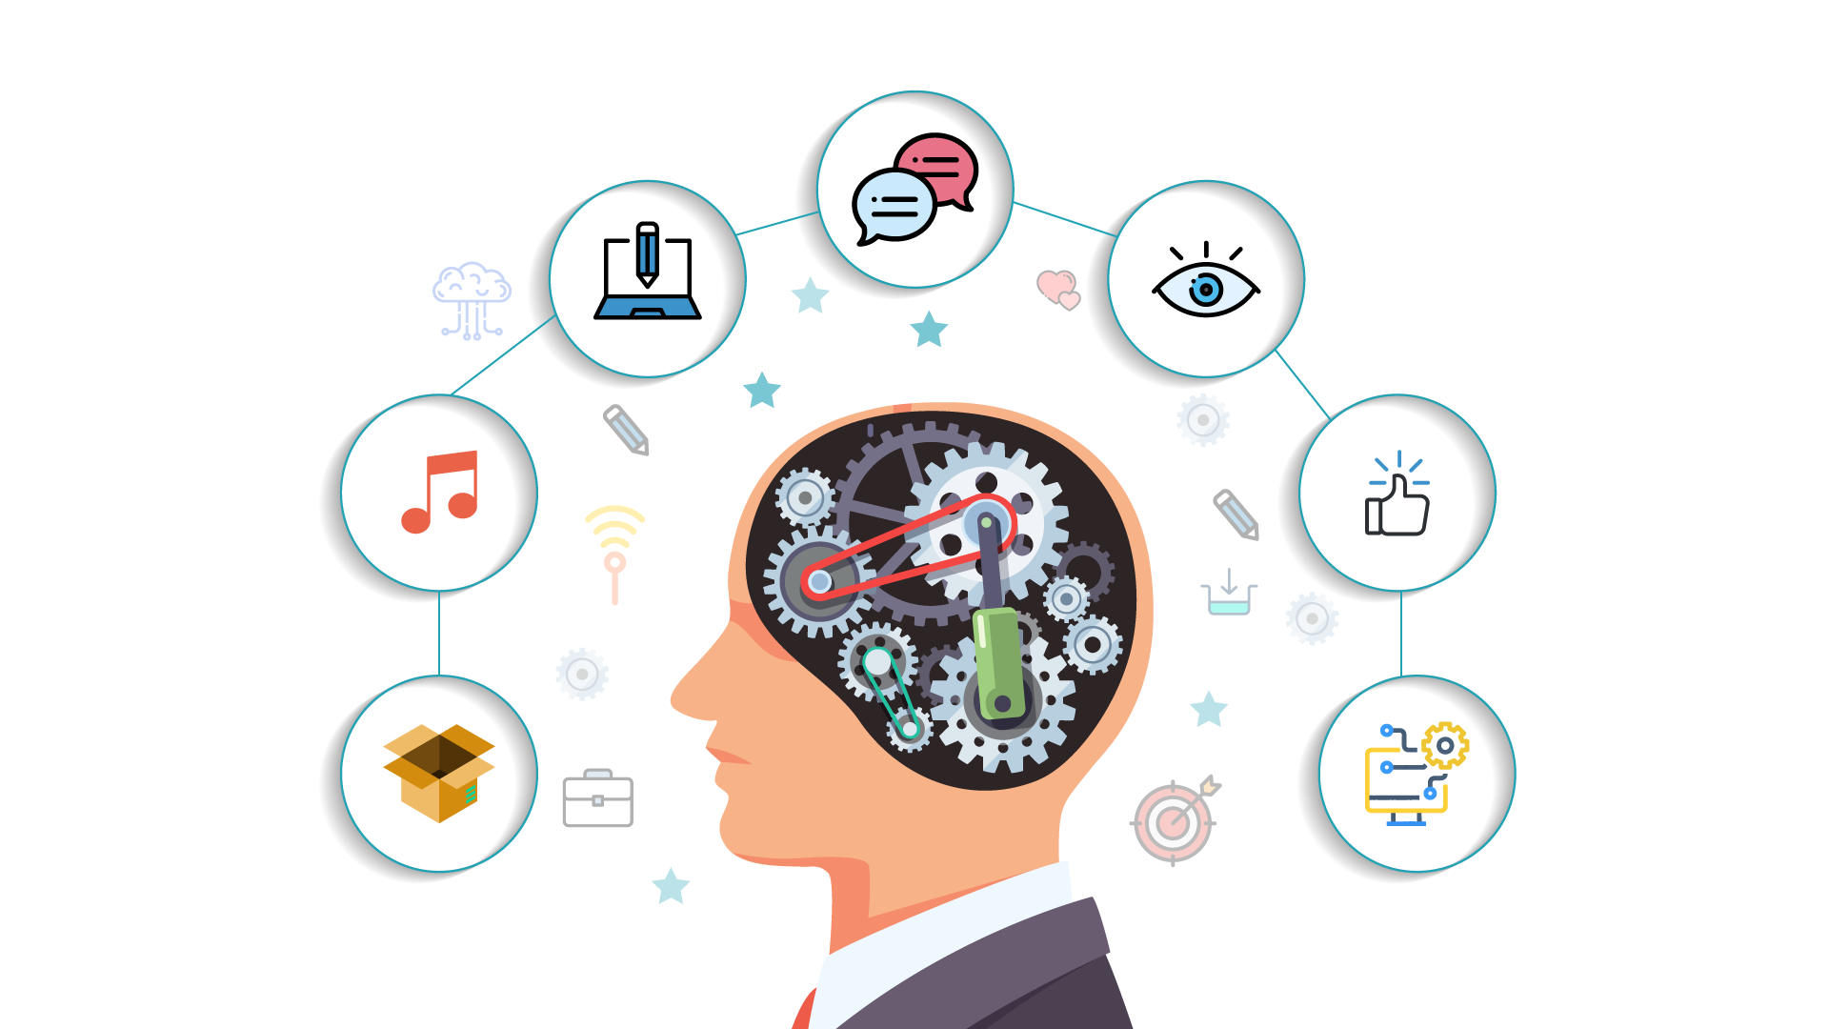
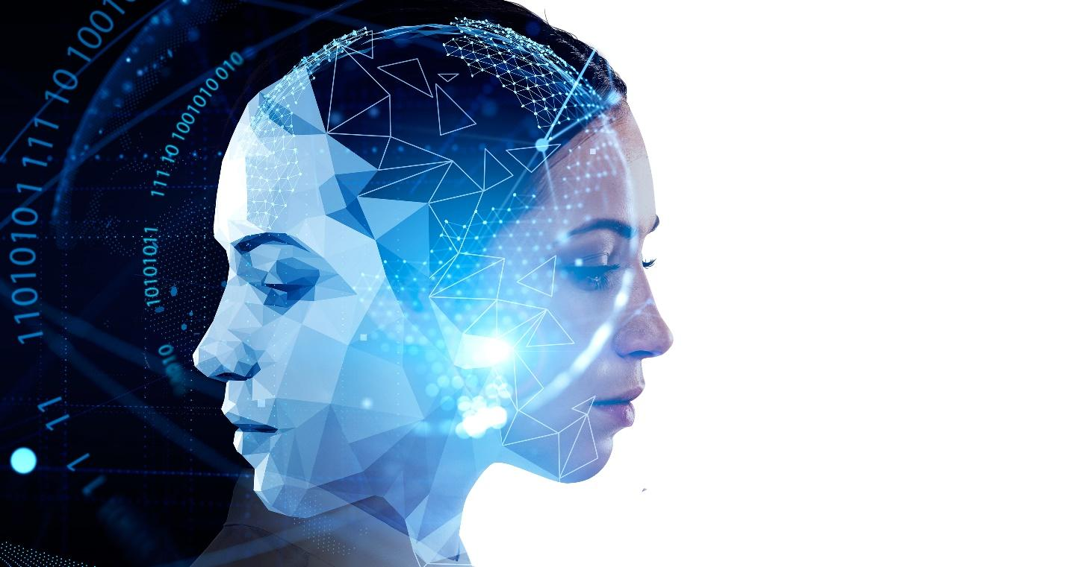
ARTIFICIAL INTELLIGENCE
AL is simulation of human intelligence in machines that are programmed to think and learn like humans.

Slide 3
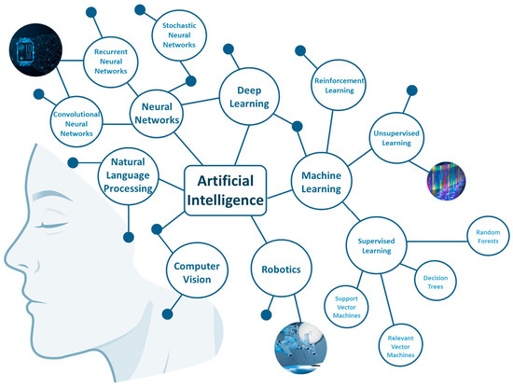
BRANCHES
OF
ARTIFICIAL
INTELLIGENCE

Slide 4
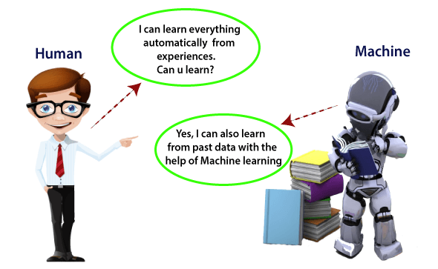

Machine learning is a growing technology which enables computers to learn .
It uses various algorithms for building mathematical models and making predictions using historical data or information.

Slide 5
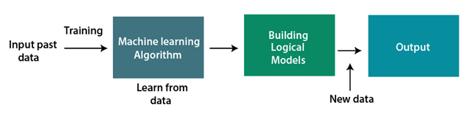
We just need to put input and output to the Machine Learning Algorithm .Machine builds the Model as and predict the output.
Notes:
We just need to put input and output to the Machine Learning Algorithm .Machine builds the Model as and predict the output.

Slide 6
10
Input
ML Algorithm
1,2,3,4
y=2x
20
Features
Labels
Mathematical
equation
2,4,6,8
Output
Model
Features, Labels and Model
Notes:
Features, Labels
and Model

Slide 7
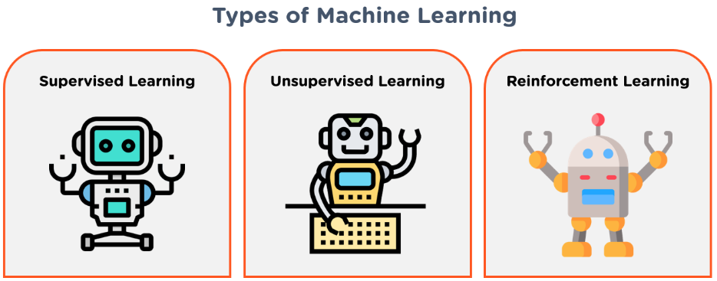

Slide 8
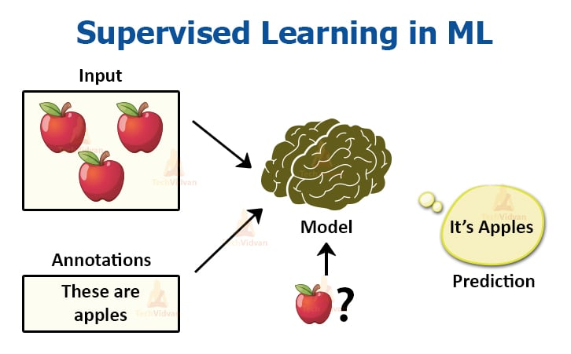
Supervised Machine Learning
If you learn from somebody is known as Supervised Machine Learning.
It has Features and Labels.
Supervised machine learning can be classified into two types
Classification
Regression

Slide 9
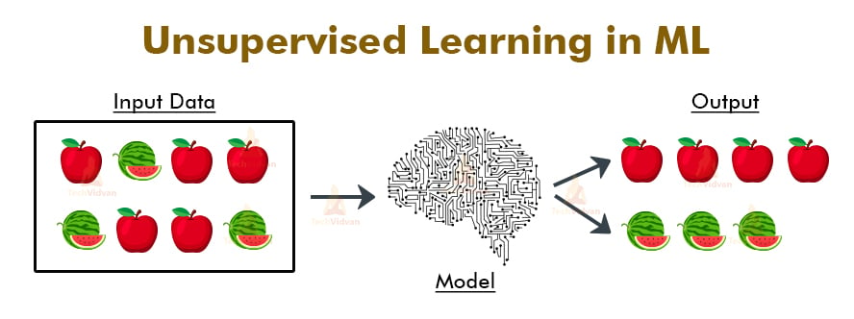
Unsupervised Machine Learning
Unsupervised Machine Learning is learn by own.
Notes:
Unsupervised Machine Learning is learn by own.

Slide 10
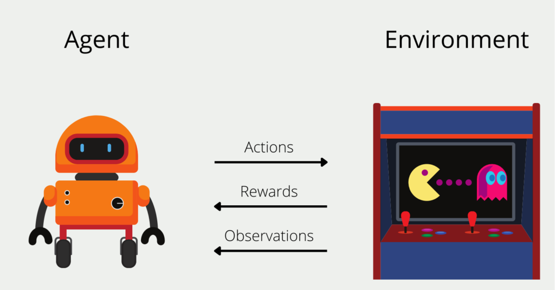
Reinforcement Learning
Agent gets rewarded for each good action and get punished for each bad action

Slide 11
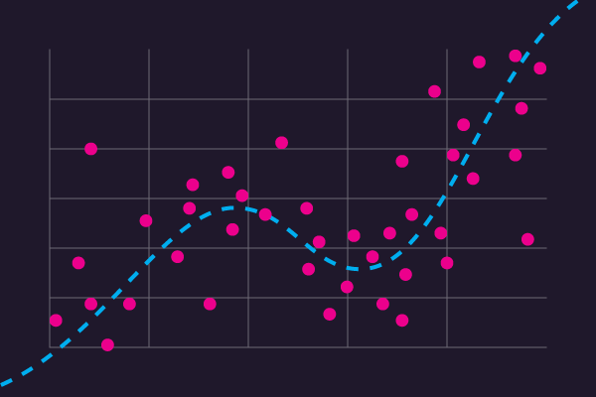
Machine Learning Algorithms with Example
Regression Algorithm
Regression algorithms are used to solve regression problems in which there is a linear relationship between input and output variables.
These are used to predict continuous output variables, such as market trends, weather prediction, etc.
In regression we use only:
Linear regression
Non-Linear regression

Slide 12
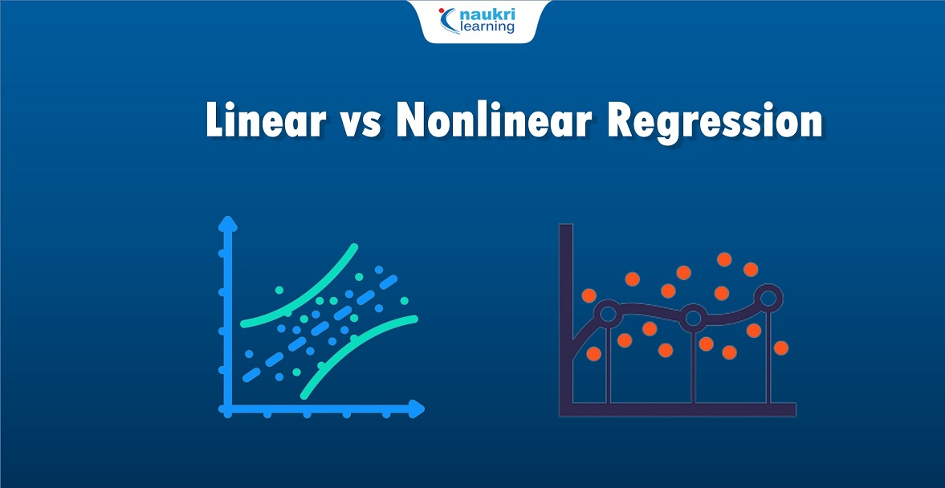

Slide 13
Classification Algorithm
Classification algorithms are used to solve the classification problems in which the output variable is categorical, such as "Yes" or No, Male or Female, Red or Blue, etc.
In classifying we use:
Logical Regression.
Decision Tree.[DT]
Random Forest.[RF]
K Nearest Neighbour[KNN]
Support Vector Machine[SVM]
Naïve Bayes

Slide 14
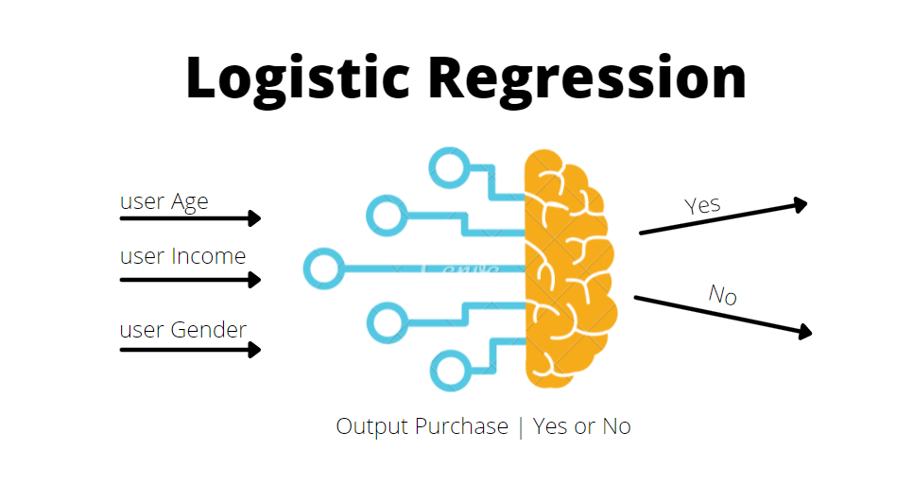
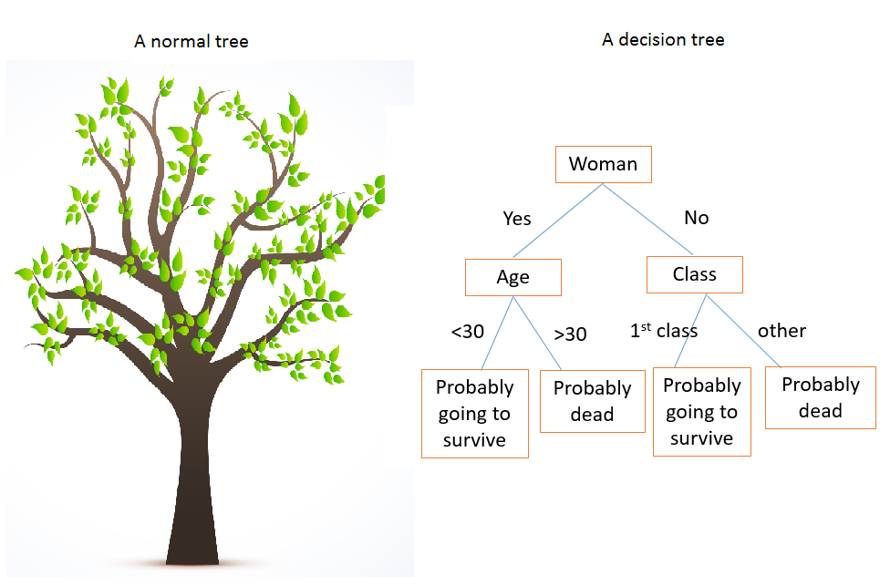

Slide 15
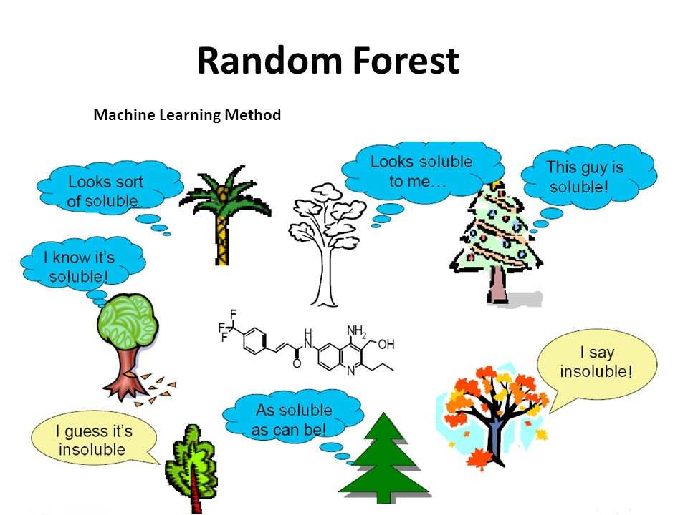
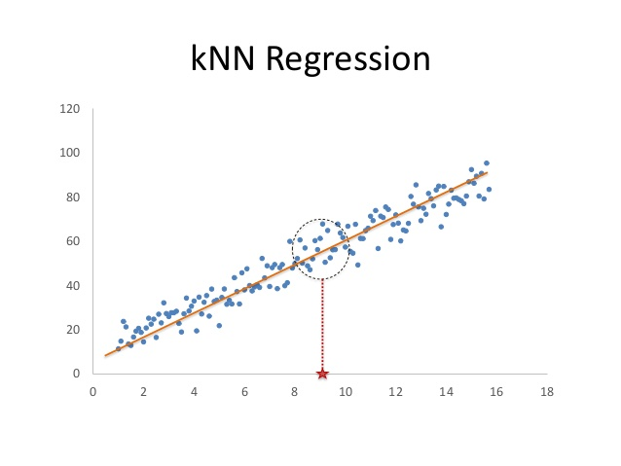

Slide 16
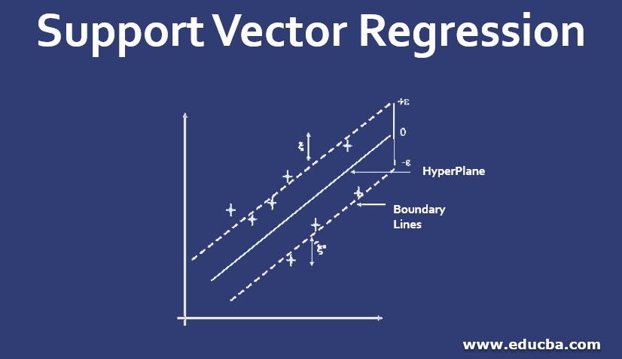
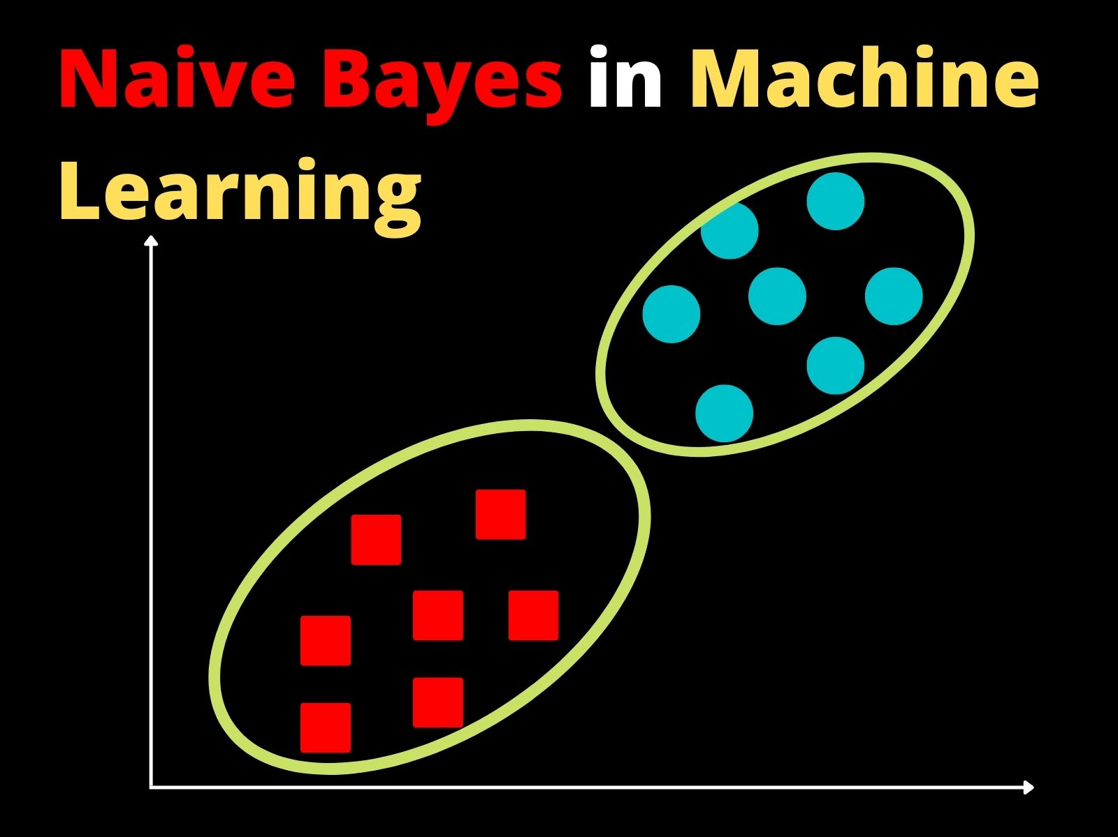

Slide 17
THANK YOU

